Slide 1
Mapping out the EBC model
&
Adapting to MS

Slide 2
Early Breast Cancer example

Slide 3
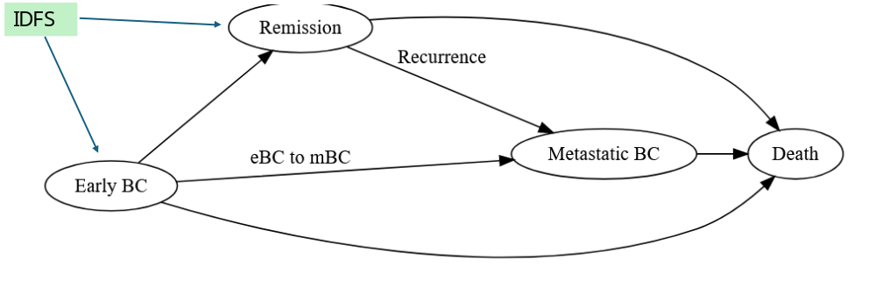
EBC Model diagram

Slide 4
Initial events; int & no int groups
initial event
Evaluate time
Change time
Intermediate/ not event
Final event
LMBC
start
idfs
recurrence
OS.mbc
ttot.early
os.early
nat.os
progression.mbc
ttot.beva
ttot
OS.mbc
os.early
nat.os
OS.early
EMBC
OS
remission
Start.early.mbc
OS.mbc
idfs
Start.early.mbc
idfs
progression.mbc
idfs
ttot.early
ttot
Clock forward

Slide 5
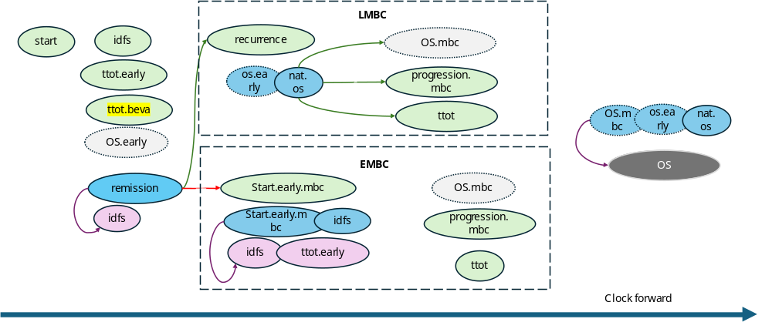
event reactions & logical flags
flag =1
Flag = 0
new event
Change initial event
Remission
recurrence
Idfs
mbcs
Idfs
tx.beva
AE
mbcs. _2ndline
AE
Idfs.ontx
os
mbcs.progression.mbc
mbcs. _2ndline
2ndline_mbc
os
Idfs.ontx
mbcs.ontx
tx.beva
mbcs.ontx
mbcs.progression.mbc
Idfs
mbcs.ontx
Remission
mbcs.progression.mbc
tx.beva
mbcs
tx.beva
mbcs
mbcs
mbcs.progression.mbc
mbcs. _2ndline
Idfs
2ndline_mbc
mbcs. _2ndline
tx.beva
AE
mbcs. _2ndline
Idfs.ontx
os
mbcs.ontx
AE
recurrence
Idfs
os
Remission 0.8

Slide 6
Multiple Sclerosis model adaptation

Slide 7
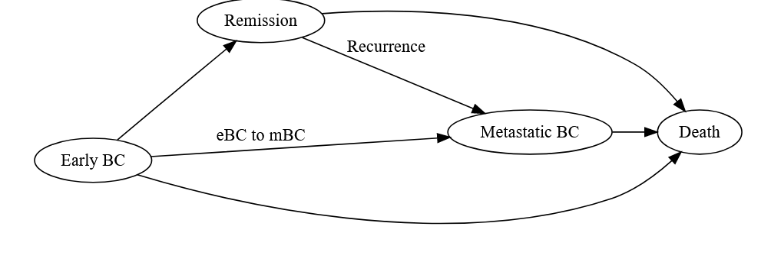
MS Model diagram
EDSS 0
IDFS
RRMS to SPMS
conversion or
delete
RRMS to SPMS
SPMSS 1-9
RRMS 1-9
Notes:
Idfs = edss0
Early BC = RRMS 1-9
Remission = RRMS to SPMS
eBC to mBC = RRMS to SPMS
Recurrence = conversion
Metastatic BC = SPMS 1-9

Slide 8
Initial events; int & no int groups
initial event
Evaluate time
Change time
Intermediate/ not event
Final event
SPMS
start
edss0
start.sp
OS.mbc
ttot.early
start.sp
edss0
os.early
nat.mort
progression.sp
edss0
ttot.early
os.early
ttot.int
ttot.sp
OS.mbc
nat.mort
Mort.trt
RRMS
death
start.rr
OS.mbc
nat.mort
rr2sp
start.rr
edss0
os.early
nat.mort
progression.rr
edss0
edss0
ttot.early
ttot.rr
Clock forward
Notes:
Idfs = edss0
ttot.early = delete?
ttot.beva = ttot.int
os.early = nat.mort
remission = rr2sp
recurrence = start.sp
nat.os = nat.mort
start.early.mbc = start.rr
os.mbc = delete?
progression.mbc = progression.rr
progression.mbc = progression.sp
ttot = ttot.rr
tott = tott.sp
os = death

Slide 9
event reactions & logical flags
flag =1
Flag = 0
new event
Change initial event
Remission
recurrence
Idfs
mbcs
edss0
tx.beva
AE
mbcs. _2ndline
AE
Idfs.ontx
os
mbcs.progression.mbc
mbcs. _2ndline
2ndline_mbc
os
edss0.ontx
mbcs.ontx
tx.beva
mbcs.ontx
mbcs.progression.mbc
Idfs
mbcs.ontx
Remission
mbcs.progression.mbc
tx.beva
mbcs
tx.beva
mbcs
mbcs
mbcs.progression.mbc
mbcs. _2ndline
Idfs
2ndline_mbc
mbcs. _2ndline
tx.beva
AE
mbcs. _2ndline
Idfs.ontx
os
mbcs.ontx
AE
recurrence
Idfs
os
Remission 0.8
Notes:
idfs = edss0
idfs.ontx = edss0.ontx
mbcs.ontx =
mbcs.progression.mbc =
tx.beva =
mbcs =
mbcs. _2ndline =
recurrence =
Remission 0.8 =
remission =

Slide 10
Model diagram
Simulate events
If SPMS Status = 0
If EDSS<9: EDSS increase (CDP3/6)
If EDSS>0: EDSS reduction
Progression to SPMS
Relapse
Adverse events
Non-event driven treatment change
Death
If SPMS Status = 1
If EDSS<9: EDSS increase
Relapse
Adverse events
Death
Death
Total costs and QALYs
Start simulation
Set baseline demographic and disease characteristics:
Age
Sex
EDSS ∈ (0,…,9)
SPMS Status = 0
Treatment
Resolve competing risks:
Select the event which occurs first
Evaluate (non-death) event
Add event costs and subtract disutility
Update demographics, EDSS, SPMS status, annual costs, annual QALYs
Update treatment if changed.

